Slide 1
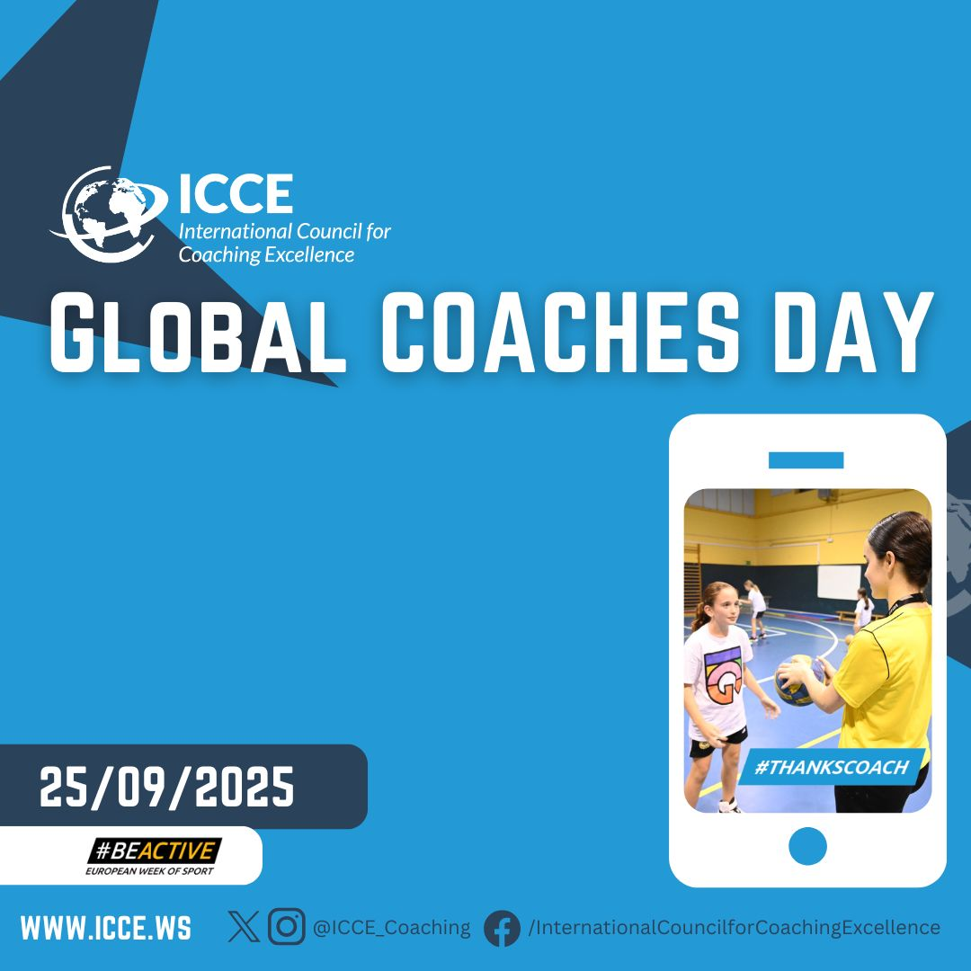
We all know the important part sport coaches play in society and healthy
lifestyles across the world.
Join us together with ICCE members across the globe in raising the profile of your coach this Coaches Day by saying #THANKSCOACH on social media!

Slide 2

We all know the important part sport coaches play in society and healthy
lifestyles across the world.
Join us together with ICCE members across the globe in raising the profile of your coach this Coaches Day by saying #THANKSCOACH on social media!

Slide 3

We all know the important part sport coaches play in society and healthy
lifestyles across the world.
Join us together with ICCE members across the globe in raising the profile of your coach this Coaches Day by saying #THANKSCOACH on social media!

Slide 4

We all know the important part sport coaches play in society and healthy
lifestyles across the world.
Join us together with ICCE members across the globe in raising the profile of your coach this Coaches Day by saying #THANKSCOACH on social media!

Slide 5
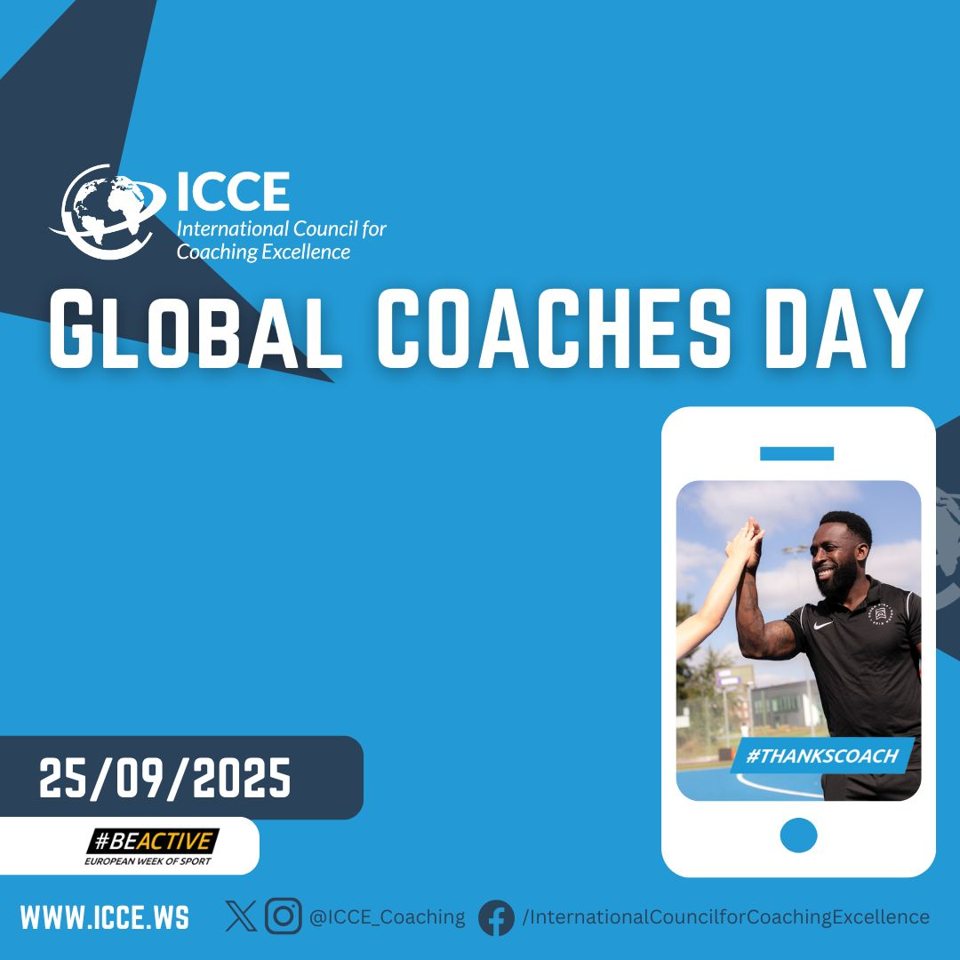
We all know the important part sport coaches play in society and healthy
lifestyles across the world.
Join us together with ICCE members across the globe in raising the profile of your coach this Coaches Day by saying #THANKSCOACH on social media!

Slide 6

We all know the important part sport coaches play in society and healthy
lifestyles across the world.
Join us together with ICCE members across the globe in raising the profile of your coach this Coaches Day by saying #THANKSCOACH on social media!

